Slide 1

Note: The data and information in this document is reflective of a hypothetical situation and client. This document is to be used for KPMG Virtual Internship purposes only.
Sprocket Central Pty Ltd
Data analytics approach
Remi Folohunso, [Junior Consultant]

Slide 2
Note: The data and information in this document is reflective of a hypothetical situation and client. This document is to be used for KPMG Virtual Internship purposes only.
Agenda
Introduction
Data Exploration
Model Development
Interpretation

Slide 3
Note: The data and information in this document is reflective of a hypothetical situation and client. This document is to be used for KPMG Virtual Internship purposes only.
Agenda
DATA ASSESMENTS
 | ACCURACY | COMPLETENESS | CURRENCY | CONSISTENCY | RELEVANT | VALIDITY
Transactions |  |  | List price, Standard cost |  | Default
NewCustomerList | Job title, wealth segment,
CustomerDemography |  | Job title, wealth segment, Gender |  | Wealth segment |  | DOB
CustomerAddress |  |  |  | State

Slide 4
Note: The data and information in this document is reflective of a hypothetical situation and client. This document is to be used for KPMG Virtual Internship purposes only.
Introduction
Task to do
1. Take a look at the following datasets provided by Sprocket Central Pty Ltd and identify all data quality issues. Once you've had a look at these datasets, draft an email to the client identifying all data quality issues.
2.Create a PowerPoint presentation which outlines the approach we will be taking to identify which of the 1000 customers Sprocket Central Pty Ltd should target, based on this dataset. Explain the three phases: Data Exploration; Model Development and Interpretation.
3. Please develop a dashboard that we can present to the client at our next meeting. Display your data summary and results of the analysis in a dashboard (see tools/references for assistance). Specifically, your presentation should specify who Sprocket Central Pty Ltd' should be targeting out of the new 1000 customer list.

Slide 5
Note: The data and information in this document is reflective of a hypothetical situation and client. This document is to be used for KPMG Virtual Internship purposes only.
Model Development
DATA CLEANING
Added a filter to the dataset of each data.
Checks for corrections
Change data types to right format
Delete banks
Delete unnecessary columns (e.g. Default column)
Merge necessary columns together in excel

Slide 6
Note: The data and information in this document is reflective of a hypothetical situation and client. This document is to be used for KPMG Virtual Internship purposes only.
Model Development
DATA PROCESSING
Exported data to MySQL for Queries
Generates queries like Total Profit, Age, Average sales, e.t.c
Generate insights for data visualizations
Check data for errors, then proceeded to data visualizations.

Slide 7
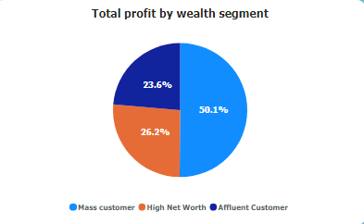
Note: The data and information in this document is reflective of a hypothetical situation and client. This document is to be used for KPMG Virtual Internship purposes only.
Data Exploration
Customer Segmentation:
I combine the customer demographic data with transactional data to analyze customer segments based on factors such as age, gender, job title, and location. This help to provide insights into the most valuable customer segments, allowing investors to tailor their marketing and business strategies accordingly.

Slide 8
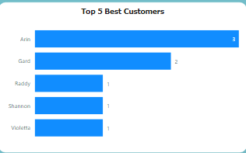
Note: The data and information in this document is reflective of a hypothetical situation and client. This document is to be used for KPMG Virtual Internship purposes only.
Data Exploration
Purchase Patterns:
Analyze transaction data to identify trends and patterns in customer purchases. This could include the most popular brands or product categories, peak sales periods, or any recurring purchasing behavior. I will Visualize this data using charts or graphs to showcase key insights to investors.

Slide 9
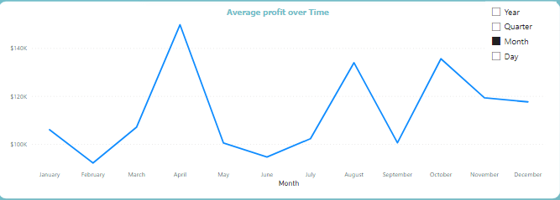
Note: The data and information in this document is reflective of a hypothetical situation and client. This document is to be used for KPMG Virtual Internship purposes only.
Model Development
Revenue and Profit Analysis:
Analyzing transactional data to track revenue and profitability over time. Visualize key performance indicators such as total revenue, average order value, or profit margins to highlight trends and key insights for investors.

Slide 10
Note: The data and information in this document is reflective of a hypothetical situation and client. This document is to be used for KPMG Virtual Internship purposes only.
End

